Slide 1
COMP 3500 Introduction to Operating Systems CPU Scheduling
Dr. Xiao Qin
Auburn University http://www.eng.auburn.edu/~xqin
xqin@auburn.edu
Notes:
Fall’17:
This slide set is covered in two separate lectures.
First Lecture
31a: 15 Minutes
31b: 30 Minutes: slides 1-25. Cont. from Slide 26
Next Lecture
31b: 50 Minutes: slides 26-44 and Scheduling excercises
Fall’16: Part 2 slides 1-20 = Part 1.
Fall’15: 50 Min: slides 1-14

Slide 2
Exercise 1 (Plickers). Processor Scheduling
The system objectives of processor scheduling include the following ones except:
Broken down into three separate functions:
Reduce response time,
Improve throughput
Minimize context switch overhead
Optimize processor efficiency
long term scheduling
medium term scheduling
short term scheduling
Notes:
The aim of processor scheduling is to assign processes to be executed by the processor
or processors over time, in a way that meets system objectives, such as response
time, throughput, and processor efficiency. In many systems, this scheduling activity
is broken down into three separate functions: long-, medium-, and short-term
scheduling. The names suggest the relative time scales with which these functions are
performed.

Slide 3
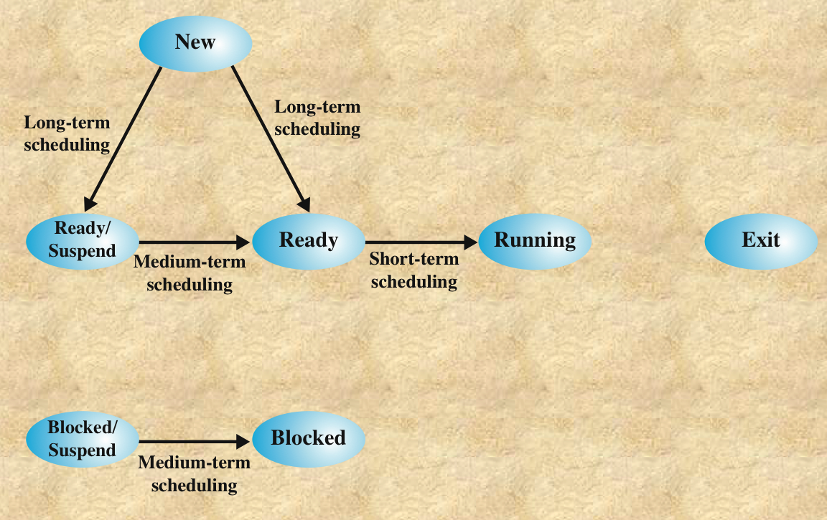
Scheduling and Process State Transitions
Notes:
The aim of processor scheduling is to assign processes to be executed by the processor
or processors over time, in a way that meets system objectives, such as response
time, throughput, and processor efficiency. In many systems, this scheduling activity
is broken down into three separate functions: long-, medium-, and short-term
scheduling. The names suggest the relative time scales with which these functions are
performed.

Slide 4
Exercise 2. What are reasons for running jobs (processes) to cease using a CPU? Can you write down one reason or two? Hint: There are four.
Preemption or voluntary yield
New
Process
Ready
List
Scheduler
CPU
Done
job
job
“Running”
job
“Ready”
Resource
Manager
Allocate
Request
job
job
“Blocked”
Resources
Model of Process Execution
Slide courtesy of Dr. Gary Nutt
Notes:
Time out
Wait for I/Os
Be preempted
Done
Wait for event (synchronization)

Slide 5
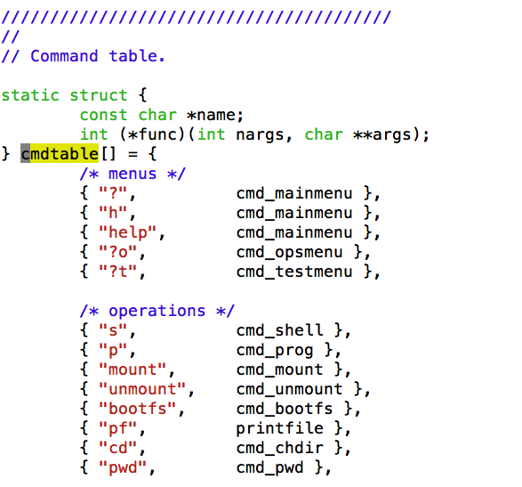
An Example of Separating Policies from Mechanisms.

Slide 6
Demonstration Separation of Scheduling Mechanism and Scheduling Policies
Scheduling Policies
Scheduling Mechanism
Notes:
Reference: https://en.wikipedia.org/wiki/Separation_of_mechanism_and_policy

Slide 7
Question: How many different potential schedules?
A CPU scheduler determines an order for the execution of its scheduled proceses.
Given n processes to be scheduled
n factorial n!
Notes:
The aim of processor scheduling is to assign processes to be executed by the processor
or processors over time, in a way that meets system objectives, such as response
time, throughput, and processor efficiency. In many systems, this scheduling activity
is broken down into three separate functions: long-, medium-, and short-term
scheduling. The names suggest the relative time scales with which these functions are
performed.

Slide 8
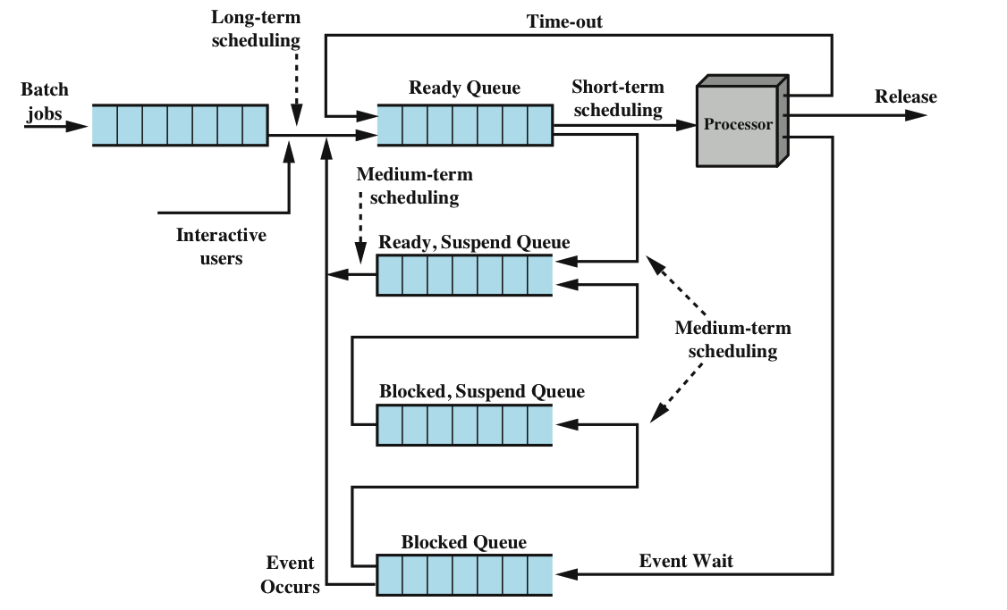
Question: Where are Long term, medium term, short term scheduling?

Slide 9
Question: Can you propose scheduling criteria?
CPU utilization – keep the CPU as busy as possible
Throughput – # of processes that complete their execution per time unit
Turnaround time – amount of time to execute a particular process
Waiting time – amount of time a process has been waiting in the ready queue
Response time – amount of time it takes from when a request was submitted until the first response is produced, not output (for time-sharing environment)
Notes:
See also Exercise 1.
Max CPU utilization
Max throughput
Min turnaround time
Min waiting time
Min response time
The main objective of short-term scheduling is to allocate processor time in such
a way as to optimize one or more aspects of system behavior. Generally, a set of
criteria is established against which various scheduling policies may be evaluated.
The commonly used criteria can be categorized along two dimensions. First,
we can make a distinction between user-oriented and system-oriented criteria.
User-oriented criteria relate to the behavior of the system as perceived by the
individual user or process. An example is response time in an interactive system.
Response time is the elapsed time between the submission of a request until the
response begins to appear as output. This quantity is visible to the user and is
naturally of interest to the user. We would like a scheduling policy that provides
“good” service to various users. In the case of response time, a threshold may be
defined, say two seconds. Then a goal of the scheduling mechanism should be to
maximize the number of users who experience an average response time of two
seconds or less.
Other criteria are system oriented. That is, the focus is on effective and
efficient utilization of the processor. An example is throughput, which is the rate
at which processes are completed. This is certainly a worthwhile measure of system
performance and one that we would like to maximize. However, it focuses on
system performance rather than service provided to the user. Thus, throughput is of
concern to a system administrator but not to the user population.
Whereas user-oriented criteria are important on virtually all systems, system-oriented
criteria are generally of minor importance on single-user systems. On a
single-user system, it probably is not important to achieve high processor utilization
or high throughput as long as the responsiveness of the system to user applications
is acceptable.

Slide 10
Scheduling Criteria
Criteria can be classified into:
Performance-related
quantitative
easily measured
Non-performance related
qualitative
hard to measure
examples:
response time
throughput
example:
Predictability
Usability
Notes:
Max CPU utilization
Max throughput
Min turnaround time
Min waiting time
Min response time
The main objective of short-term scheduling is to allocate processor time in such
a way as to optimize one or more aspects of system behavior. Generally, a set of
criteria is established against which various scheduling policies may be evaluated.
The commonly used criteria can be categorized along two dimensions. First,
we can make a distinction between user-oriented and system-oriented criteria.
User-oriented criteria relate to the behavior of the system as perceived by the
individual user or process. An example is response time in an interactive system.
Response time is the elapsed time between the submission of a request until the
response begins to appear as output. This quantity is visible to the user and is
naturally of interest to the user. We would like a scheduling policy that provides
“good” service to various users. In the case of response time, a threshold may be
defined, say two seconds. Then a goal of the scheduling mechanism should be to
maximize the number of users who experience an average response time of two
seconds or less.
Other criteria are system oriented. That is, the focus is on effective and
efficient utilization of the processor. An example is throughput, which is the rate
at which processes are completed. This is certainly a worthwhile measure of system
performance and one that we would like to maximize. However, it focuses on
system performance rather than service provided to the user. Thus, throughput is of
concern to a system administrator but not to the user population.
Whereas user-oriented criteria are important on virtually all systems, system-oriented
criteria are generally of minor importance on single-user systems. On a
single-user system, it probably is not important to achieve high processor utilization
or high throughput as long as the responsiveness of the system to user applications
is acceptable.

Slide 11
Wait Time vs. Turnaround Time
Let P = {p_{i} | 0 ≤ i < n} = set of processes
Let S(p_{i}) ∈ {running, ready, blocked}
Let t(p_{i}) = Time process needs to be in running state (the service time)
Let W(p_{i}) = Time p_{i} is in ready state before first transition to running (wait time)
Let T_{TRnd}(p_{i}) = Time from p_{i} first enter ready to last exit ready (turnaround time)
Batch Throughput rate = inverse of avg T_{TRnd}
Timesharing response time = W(p_{i})

Slide 12
First-Come-First-Served
i τ(p_{i})
0 350
1 125
2 475
3 250
4 75
0
350
p₀
T_{TRnd}(p₀) = τ(p₀) = 350
W(p₀) = 0

Slide 13
First-Come-First-Served
i τ(p_{i})
0 350
1 125
2 475
3 250
4 75
350
475
p₀
p₁
T_{TRnd}(p₀) = τ(p₀) = 350
T_{TRnd}(p₁) = (τ(p₁) +T_{TRnd}(p₀)) = 125+350 = 475
W(p₀) = 0
W(p₁) = T_{TRnd}(p₀) = 350

Slide 14
First-Come-First-Served
i τ(p_{i})
0 350
1 125
2 475
3 250
4 75
475
950
p₀
p₁
p₂
T_{TRnd}(p₀) = τ(p₀) = 350
T_{TRnd}(p₁) = (τ(p₁) +T_{TRnd}(p₀)) = 125+350 = 475
T_{TRnd}(p₂) = (τ(p₂) +T_{TRnd}(p₁)) = 475+475 = 950
W(p₀) = 0
W(p₁) = T_{TRnd}(p₀) = 350
W(p₂) = T_{TRnd}(p₁) = 475

Slide 15
First-Come-First-Served
i τ(p_{i})
0 350
1 125
2 475
3 250
4 75
950
1200
p₀
p₁
p₂
p₃
T_{TRnd}(p₀) = τ(p₀) = 350
T_{TRnd}(p₁) = (τ(p₁) +T_{TRnd}(p₀)) = 125+350 = 475
T_{TRnd}(p₂) = (τ(p₂) +T_{TRnd}(p₁)) = 475+475 = 950
T_{TRnd}(p₃) = (τ(p₃) +T_{TRnd}(p₂)) = 250+950 = 1200
W(p₀) = 0
W(p₁) = T_{TRnd}(p₀) = 350
W(p₂) = T_{TRnd}(p₁) = 475
W(p₃) = T_{TRnd}(p₂) = 950

Slide 16
First-Come-First-Served
i τ(p_{i})
0 350
1 125
2 475
3 250
4 75
1200
1275
p₀
p₁
p₂
p₃
p₄
T_{TRnd}(p₀) = τ(p₀) = 350
T_{TRnd}(p₁) = (τ(p₁) +T_{TRnd}(p₀)) = 125+350 = 475
T_{TRnd}(p₂) = (τ(p₂) +T_{TRnd}(p₁)) = 475+475 = 950
T_{TRnd}(p₃) = (τ(p₃) +T_{TRnd}(p₂)) = 250+950 = 1200
T_{TRnd}(p₄) = (τ(p₄) +T_{TRnd}(p₃)) = 75+1200 = 1275
W(p₀) = 0
W(p₁) = T_{TRnd}(p₀) = 350
W(p₂) = T_{TRnd}(p₁) = 475
W(p₃) = T_{TRnd}(p₂) = 950
W(p₄) = T_{TRnd}(p₃) = 1200

Slide 17
FCFS Average Wait Time
i τ(p_{i})
0 350
1 125
2 475
3 250
4 75
0
350
475
900
1200
1275
p₀
p₁
p₂
p₃
p₄
T_{TRnd}(p₀) = τ(p₀) = 350
T_{TRnd}(p₁) = (τ(p₁) +T_{TRnd}(p₀)) = 125+350 = 475
T_{TRnd}(p₂) = (τ(p₂) +T_{TRnd}(p₁)) = 475+475 = 950
T_{TRnd}(p₃) = (τ(p₃) +T_{TRnd}(p₂)) = 250+950 = 1200
T_{TRnd}(p₄) = (τ(p₄) +T_{TRnd}(p₃)) = 75+1200 = 1275
W(p₀) = 0
W(p₁) = T_{TRnd}(p₀) = 350
W(p₂) = T_{TRnd}(p₁) = 475
W(p₃) = T_{TRnd}(p₂) = 950
W(p₄) = T_{TRnd}(p₃) = 1200
W_{TRand_avg} = 850
W_{avg} = (0+350+475+950+1200)/5 = 2974/5 = 595
Notes:
Easy to implement
Ignores service time, etc
Not a great performer

Slide 18
Exercise 3 (Plickers). Which one of the following statements is an advantage of FCFS?
Easy to implement
Consider service time
A great performer
Reduce average wait time
Notes:
Easy to implement
Ignores service time, etc
Not a great performer

Slide 19
Exercise 3 (Plickers). The shortest job next scheduling algorithm schedules the following five jobs.
(3.1) What is the average turn around time?
A. 315 B. 600 C. 560 D. 480
(3.2) What is the average waiting time?
A. 285 B. 320 C. 410 D. 305
i τ(p_{i})
0 350
1 125
2 475
3 250
4 75
T_{TRnd}(p₄) = τ(p₄) = 75
W(p₄) = 0
0
75
p₄
Notes:
Associate with each process the length of its next CPU burst
Use these lengths to schedule the process with the shortest time
SJF is optimal – gives minimum average waiting time for a given set of processes
The difficulty is knowing the length of the next CPU request
Could ask the user

Slide 20
Shortest Job Next
i τ(p_{i})
0 350
1 125
2 475
3 250
4 75
0
75
200
p₄
p₁
T_{TRnd}(p₁) = τ(p₁)+τ(p₄) = 125+75 = 200
T_{TRnd}(p₄) = τ(p₄) = 75
W(p₁) = 75
W(p₄) = 0

Slide 21
Shortest Job Next
i τ(p_{i})
0 350
1 125
2 475
3 250
4 75
0
75
200
450
p₄
p₁
p₃
T_{TRnd}(p₁) = τ(p₁)+τ(p₄) = 125+75 = 200
T_{TRnd}(p₃) = τ(p₃)+τ(p₁)+τ(p₄) = 250+125+75 = 450
T_{TRnd}(p₄) = τ(p₄) = 75
W(p₁) = 75
W(p₃) = 200
W(p₄) = 0

Slide 22
Shortest Job Next
i τ(p_{i})
0 350
1 125
2 475
3 250
4 75
0
75
200
450
800
p₄
p₁
p₃
p₀
T_{TRnd}(p₀) = τ(p₀)+τ(p₃)+τ(p₁)+τ(p₄) = 350+250+125+75 = 800
T_{TRnd}(p₁) = τ(p₁)+τ(p₄) = 125+75 = 200
T_{TRnd}(p₃) = τ(p₃)+τ(p₁)+τ(p₄) = 250+125+75 = 450
T_{TRnd}(p₄) = τ(p₄) = 75
W(p₀) = 450
W(p₁) = 75
W(p₃) = 200
W(p₄) = 0

Slide 23
Shortest Job Next
i τ(p_{i})
0 350
1 125
2 475
3 250
4 75
0
75
200
450
800
1275
p₄
p₁
p₃
p₀
p₂
T_{TRnd}(p₀) = τ(p₀)+τ(p₃)+τ(p₁)+τ(p₄) = 350+250+125+75 = 800
T_{TRnd}(p₁) = τ(p₁)+τ(p₄) = 125+75 = 200
T_{TRnd}(p₂) = τ(p₂)+τ(p₀)+τ(p₃)+τ(p₁)+τ(p₄) = 475+350+250+125+75
= 1275
T_{TRnd}(p₃) = τ(p₃)+τ(p₁)+τ(p₄) = 250+125+75 = 450
T_{TRnd}(p₄) = τ(p₄) = 75
W(p₀) = 450
W(p₁) = 75
W(p₂) = 800
W(p₃) = 200
W(p₄) = 0

Slide 24
Shortest Job Next
i τ(p_{i})
0 350
1 125
2 475
3 250
4 75
0
75
200
450
800
1275
p₄
p₁
p₃
p₀
p₂
T_{TRnd}(p₀) = τ(p₀)+τ(p₃)+τ(p₁)+τ(p₄) = 350+250+125+75 = 800
T_{TRnd}(p₁) = τ(p₁)+τ(p₄) = 125+75 = 200
T_{TRnd}(p₂) = τ(p₂)+τ(p₀)+τ(p₃)+τ(p₁)+τ(p₄) = 475+350+250+125+75
= 1275
T_{TRnd}(p₃) = τ(p₃)+τ(p₁)+τ(p₄) = 250+125+75 = 450
T_{TRnd}(p₄) = τ(p₄) = 75
W(p₀) = 450
W(p₁) = 75
W(p₂) = 800
W(p₃) = 200
W(p₄) = 0
W_{TRand_avg} = 560
W_{avg} = (450+75+800+200+0)/5 = 1525/5 = 305

Slide 25
Exercise 5 (Plickers). Which one of the following statements about the shortest-job-next (SJN) policy is incorrect?
SJN minimizes wait time
SJN may starve large jobs
SJN is easier implemented than FIFO (a.k.a., FCFS)
SJN must know service times
Notes:
Minimizes wait time
May starve large jobs
Must know service times

Slide 26
Priority Scheduling
i τ(p_{i}) Pri
0 350 5
1 125 2
2 475 3
3 250 1
4 75 4
Q7: Pros and Cons
Reflects importance of external use
May cause starvation
Can address starvation with aging
0
250
375
850
925
1275
p₃
p₁
p₂
p₄
p₀
T_{TRnd}(p₀) = τ(p₀)+τ(p₄)+τ(p₂)+τ(p₁) )+τ(p₃) = 350+75+475+125+250
= 1275
T_{TRnd}(p₁) = τ(p₁)+τ(p₃) = 125+250 = 375
T_{TRnd}(p₂) = τ(p₂)+τ(p₁)+τ(p₃) = 475+125+250 = 850
T_{TRnd}(p₃) = τ(p₃) = 250
T_{TRnd}(p₄) = τ(p₄)+ τ(p₂)+ τ(p₁)+τ(p₃) = 75+475+125+250 = 925
W(p₀) = 925
W(p₁) = 250
W(p₂) = 375
W(p₃) = 0
W(p₄) = 850
W_{TRand_avg} = 735
W_{avg} = (925+250+375+0+850)/5 = 2400/5 = 480
Notes:
A priority number (integer) is associated with each process
The CPU is allocated to the process with the highest priority (smallest integer ≡ highest priority)
Preemptive
Nonpreemptive
SJF is priority scheduling where priority is the inverse of predicted next CPU burst time
Problem ≡ Starvation – low priority processes may never execute
Solution ≡ Aging – as time progresses increase the priority of the process

Slide 27
Deadline Scheduling
i τ(p_{i}) Deadline
0 350 575
1 125 550
2 475 1050
3 250 (none)
4 75 200
Allocates service by deadline
May not be feasible
d4
d1
d0
d2
200
550
575
1050
0
1275
p₁
p₄
p₀
p₂
p₃
p₄
p₁
p₀
p₂
p₃
p₄
p₀
p₁
p₂
p₃

Slide 28
Preemptive Schedulers
Preemption or voluntary yield
New
Process
Ready
List
Scheduler
CPU
Done
Highest priority process is guaranteed to be running at all times
Or at least at the beginning of a time slice
Dominant form of contemporary scheduling
But complex to build & analyze

Slide 29
Round Robin (TQ=50)
i τ(p_{i})
0 350
1 125
2 475
3 250
4 75
0
50
p₀
W(p₀) = 0
Notes:
Each process gets a small unit of CPU time (time quantum q), usually 10-100 milliseconds. After this time has elapsed, the process is preempted and added to the end of the ready queue.
If there are n processes in the ready queue and the time quantum is q, then each process gets 1/n of the CPU time in chunks of at most q time units at once. No process waits more than (n-1)q time units.
Timer interrupts every quantum to schedule next process
Performance
q large ⇒ FIFO
q small ⇒ q must be large with respect to context switch, otherwise overhead is too high

Slide 30
Round Robin (TQ=50)
i τ(p_{i})
0 350
1 125
2 475
3 250
4 75
0
100
p₀
p₁
W(p₀) = 0
W(p₁) = 50

Slide 31
Round Robin (TQ=50)
i τ(p_{i})
0 350
1 125
2 475
3 250
4 75
0
100
p₀
p₁
p₂
W(p₀) = 0
W(p₁) = 50
W(p₂) = 100

Slide 32
Round Robin (TQ=50)
i τ(p_{i})
0 350
1 125
2 475
3 250
4 75
0
100
200
p₀
p₁
p₂
p₃
W(p₀) = 0
W(p₁) = 50
W(p₂) = 100
W(p₃) = 150

Slide 33
Round Robin (TQ=50)
i τ(p_{i})
0 350
1 125
2 475
3 250
4 75
0
100
200
p₀
p₁
p₂
p₃
p₄
W(p₀) = 0
W(p₁) = 50
W(p₂) = 100
W(p₃) = 150
W(p₄) = 200

Slide 34
Round Robin (TQ=50)
i τ(p_{i})
0 350
1 125
2 475
3 250
4 75
0
100
200
300
p₀
p₁
p₂
p₃
p₄
p₀
W(p₀) = 0
W(p₁) = 50
W(p₂) = 100
W(p₃) = 150
W(p₄) = 200

Slide 35
Round Robin (TQ=50)
i τ(p_{i})
0 350
1 125
2 475
3 250
4 75
0
100
200
300
400
475
p₀
p₁
p₂
p₃
p₄
p₀
p₁
p₂
p₃
p₄
T_{TRnd}(p₄) = 475
W(p₀) = 0
W(p₁) = 50
W(p₂) = 100
W(p₃) = 150
W(p₄) = 200

Slide 36
Round Robin (TQ=50)
i τ(p_{i})
0 350
1 125
2 475
3 250
4 75
0
100
200
300
400
475
550
p₀
p₁
p₂
p₃
p₄
p₀
p₁
p₂
p₃
p₄
p₀
p₁
T_{TRnd}(p₁) = 550
T_{TRnd}(p₄) = 475
W(p₀) = 0
W(p₁) = 50
W(p₂) = 100
W(p₃) = 150
W(p₄) = 200

Slide 37
Round Robin (TQ=50)
i τ(p_{i})
0 350
1 125
2 475
3 250
4 75
0
100
200
300
400
475
550
650
p₀
p₁
p₂
p₃
p₄
p₀
p₁
p₂
p₃
p₄
p₀
p₁
p₂
p₃
650
750
850
950
p₀
p₂
p₃
p₀
p₂
p₃
T_{TRnd}(p₁) = 550
T_{TRnd}(p₃) = 950
T_{TRnd}(p₄) = 475
W(p₀) = 0
W(p₁) = 50
W(p₂) = 100
W(p₃) = 150
W(p₄) = 200

Slide 38
Round Robin (TQ=50)
i τ(p_{i})
0 350
1 125
2 475
3 250
4 75
0
100
200
300
400
475
550
650
p₀
p₁
p₂
p₃
p₄
p₀
p₁
p₂
p₃
p₄
p₀
p₁
p₂
p₃
650
750
850
950
1050
p₀
p₂
p₃
p₀
p₂
p₃
p₀
p₂
p₀
T_{TRnd}(p₀) = 1100
T_{TRnd}(p₁) = 550
T_{TRnd}(p₃) = 950
T_{TRnd}(p₄) = 475
W(p₀) = 0
W(p₁) = 50
W(p₂) = 100
W(p₃) = 150
W(p₄) = 200

Slide 39
Round Robin (TQ=50)
i τ(p_{i})
0 350
1 125
2 475
3 250
4 75
0
100
200
300
400
475
550
650
p₀
p₁
p₂
p₃
p₄
p₀
p₁
p₂
p₃
p₄
p₀
p₁
p₂
p₃
650
750
850
950
1050
1150
1250
1275
p₀
p₂
p₃
p₀
p₂
p₃
p₀
p₂
p₀
p₂
p₂
p₂
p₂
T_{TRnd}(p₀) = 1100
T_{TRnd}(p₁) = 550
T_{TRnd}(p₂) = 1275
T_{TRnd}(p₃) = 950
T_{TRnd}(p₄) = 475
W(p₀) = 0
W(p₁) = 50
W(p₂) = 100
W(p₃) = 150
W(p₄) = 200

Slide 40
Round Robin (TQ=50)
Equitable
Most widely-used
Fits naturally with interval timer
i τ(p_{i})
0 350
1 125
2 475
3 250
4 75
0
100
200
300
400
475
550
650
p₀
p₁
p₂
p₃
p₄
p₀
p₁
p₂
p₃
p₄
p₀
p₁
p₂
p₃
650
750
850
950
1050
1150
1250
1275
p₀
p₂
p₃
p₀
p₂
p₃
p₀
p₂
p₀
p₂
p₂
p₂
p₂
T_{TRnd}(p₀) = 1100
T_{TRnd}(p₁) = 550
T_{TRnd}(p₂) = 1275
T_{TRnd}(p₃) = 950
T_{TRnd}(p₄) = 475
W(p₀) = 0
W(p₁) = 50
W(p₂) = 100
W(p₃) = 150
W(p₄) = 200
T_{TRnd}__{avg} = (1100+550+1275+950+475)/5 = 4350/5 = 870
W_{avg} = (0+50+100+150+200)/5 = 500/5 = 100

Slide 41
RR with Overhead=10 (TQ=50)
i τ(p_{i})
0 350
1 125
2 475
3 250
4 75
Overhead must be considered
0
120
240
360
480
540
575
635
670
790
p₀
p₁
p₂
p₃
p₄
p₀
p₁
p₂
p₃
p₄
p₀
p₁
p₂
p₃
790
910
1030
1150
1270
1390
1510
1535
p₀
p₂
p₃
p₀
p₂
p₃
p₀
p₂
p₀
p₂
p₂
p₂
p₂
T_{TRnd}(p₀) = 1320
T_{TRnd}(p₁) = 660
T_{TRnd}(p₂) = 1535
T_{TRnd}(p₃) = 1140
T_{TRnd}(p₄) = 565
W(p₀) = 0
W(p₁) = 60
W(p₂) = 120
W(p₃) = 180
W(p₄) = 240
T_{TRnd}__{avg} = (1320+660+1535+1140+565)/5 = 5220/5 = 1044
W_{avg} = (0+60+120+180+240)/5 = 600/5 = 120

Slide 42
Summary
Model of Process Execution
Scheduling Criteria
Scheduling Algoritnms
FCFS
SJF
Priority Scheduling
Round Robin

Slide 43
Exercise
Suppose that a scheduling algorithm (at the level of short-term CPU scheduling) favors those processes that have used the least processor time in the past.
Why this scheduling policy favor I/O-bound processes and yet not permanently starve CPU-bound processes?

